Slide 1

Note: The data and information in this document is reflective of a hypothetical situation and client. This document is to be used for KPMG Virtual Internship purposes only.
Sprocket Central Pty Ltd
Data analytics approach
[Analytics division] – Kaleb Alemayehu[Junior Consultant]

Slide 2
Note: The data and information in this document is reflective of a hypothetical situation and client. This document is to be used for KPMG Virtual Internship purposes only.
Agenda
Introduction
Data Exploration
Model Development
Interpretation

Slide 3
Customer analysis
Vehicle owners and non-vehicle owners
Profession category/ purchasing ability
Age
Past Purchasing habits of sports equipment.

Slide 4
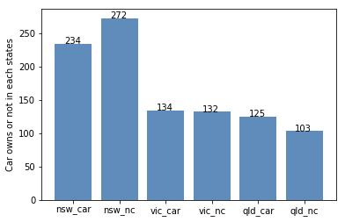
Viechel possession
New south wales has the largest non- car owner customers.
The pattern for the states can be summarized as shown below.

Slide 5
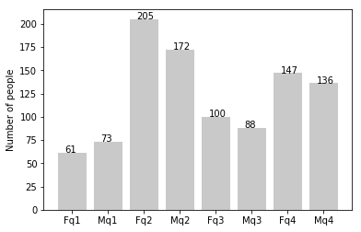
Age
Majority of customers reported being between 30-45.
Number of customers above the age of 45 decreases significantly.
Number of customers below 30 remained relatively constant.
F- female q1- <30
M- male q2- 30-45
q3- 45- 59
q4- >59

Slide 6
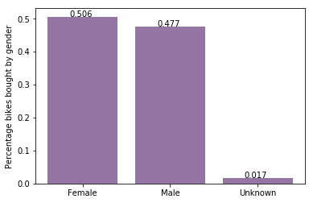
Past purchasing habits
50.6% of new customers have been female, purchasing a total of 25,212 bicycles.
Males contribute to the rest with a total purchase of 23,765.
Ads should be more appealing to women.

Slide 7
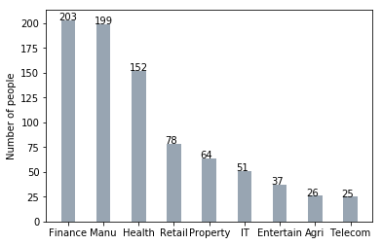
Profession category
Customers in finance and manufacturing makeup majority of new customers

Slide 8
Note: The data and information in this document is reflective of a hypothetical situation and client. This document is to be used for KPMG Virtual Internship purposes only.
Appendix
https://www.abs.gov.au/statistics?opendocument&ref=topBar
Australian Bureau of Statistics
Australian Bureau of Statistics Logo of the ABS with coat of arms.

